Slide 1
Serial Peripheral Interface
Dr. Qamaruddin

Slide 2


















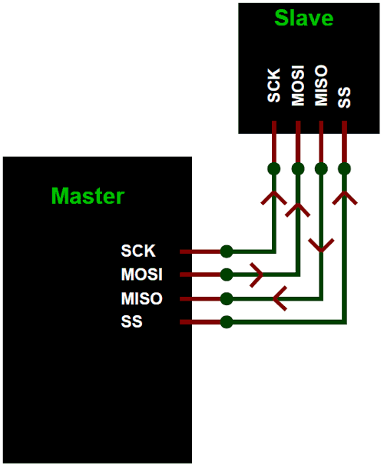












Slide 3































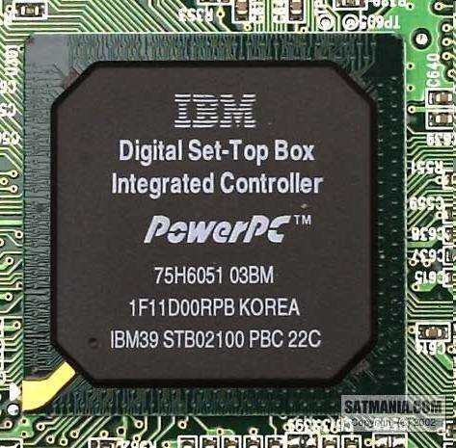
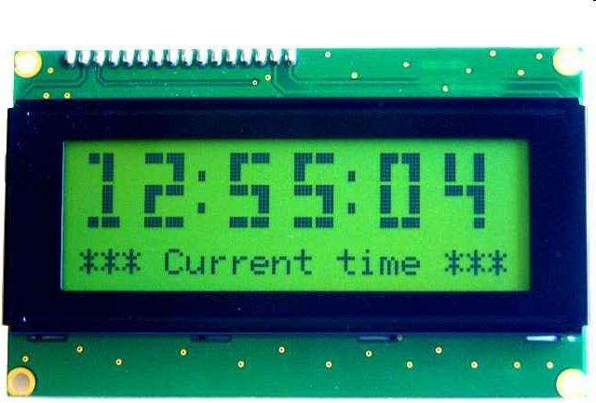

Slide 4


































Slide 5












































Slide 6

















































Slide 7





































































Slide 8











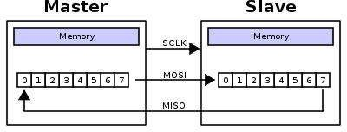









Slide 9






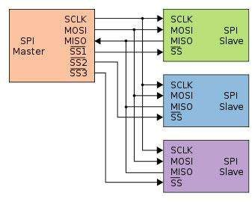
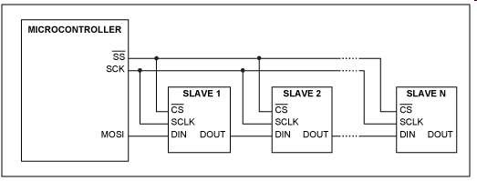








Slide 10






























































































Slide 11




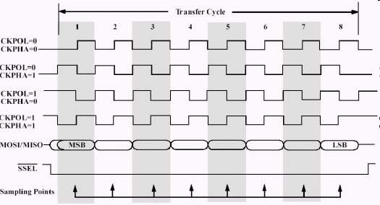





Slide 12
























































Slide 13




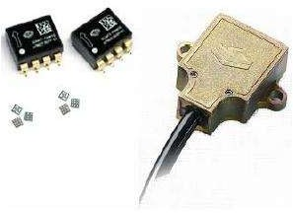




















Slide 14
































































Slide 15





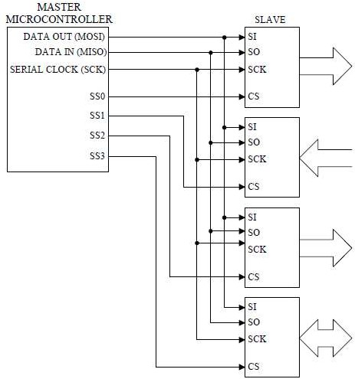






Slide 16

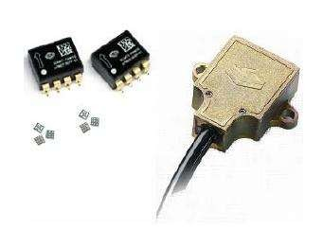

Slide 17
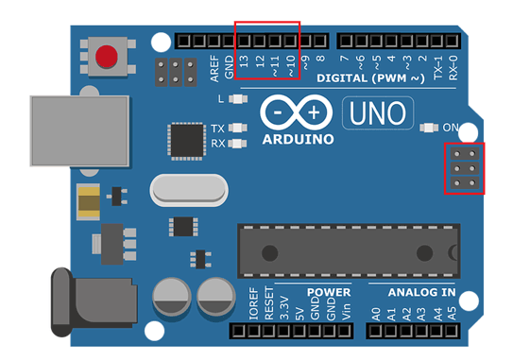
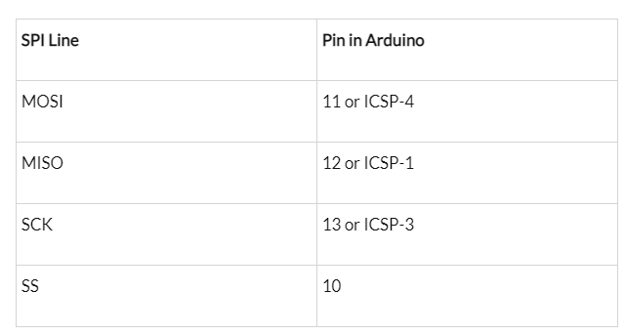
SPI Pins In Arduino

Slide 18
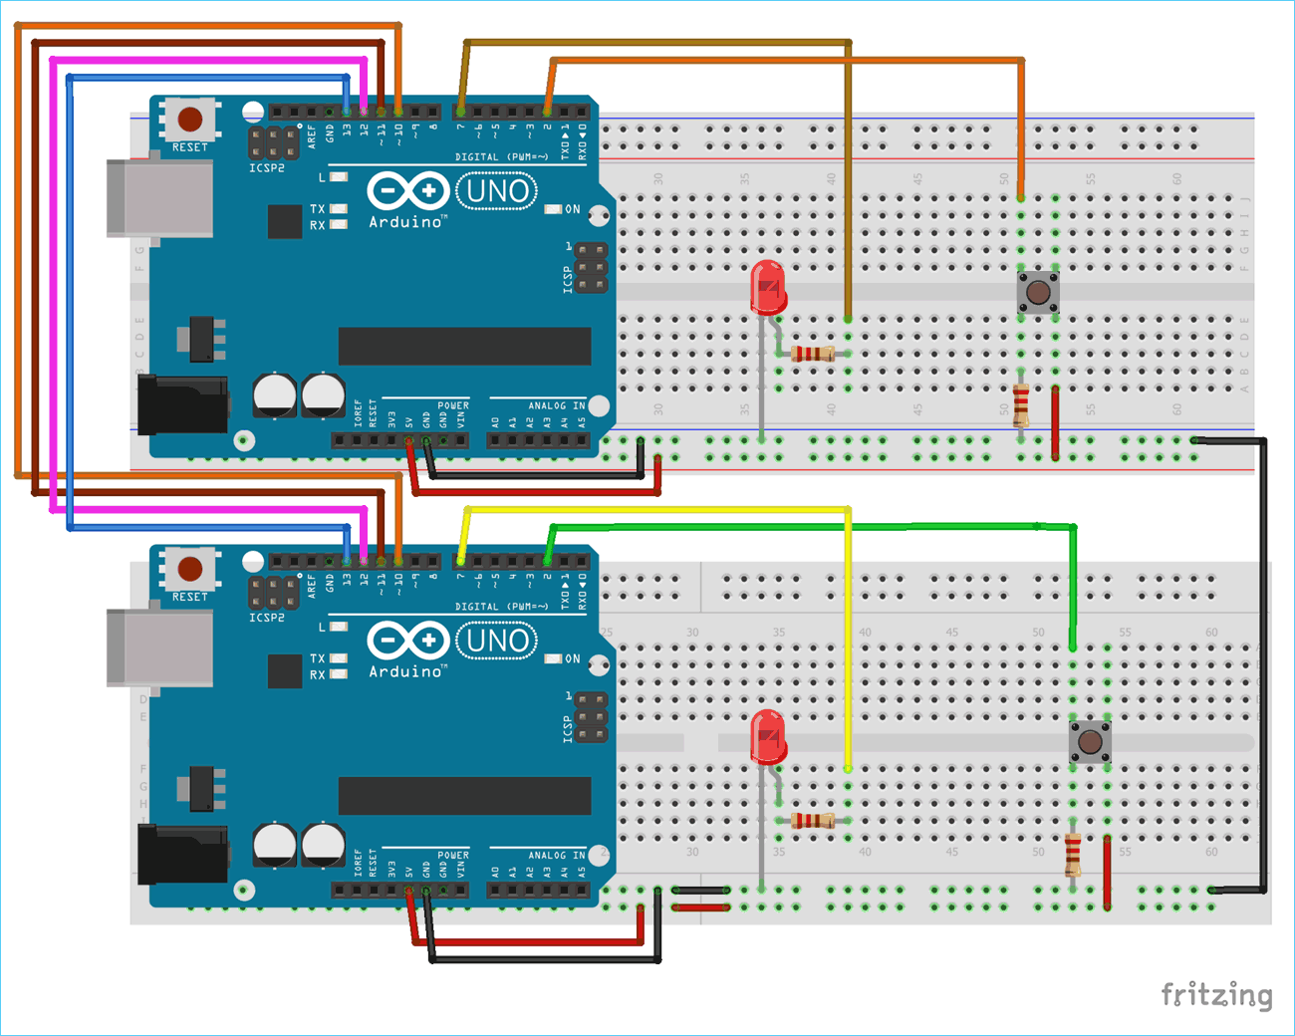
SPI Protocol Circuits

Slide 19
SPI code for Master
//SPI MASTER (ARDUINO) //SPI COMMUNICATION BETWEEN TWO ARDUINO //CIRCUIT DIGEST
#include<SPI.h> //Library for SPI #define LED 7 #define ipbutton 2 int buttonvalue; int x; void setup (void)
{ Serial.begin(115200); //Starts Serial Communication at Baud Rate 115200 pinMode(ipbutton,INPUT); //Sets pin 2 as input pinMode(LED,OUTPUT); //Sets pin 7 as Output SPI.begin(); //Begins the SPI commnuication SPI.setClockDivider(SPI_CLOCK_DIV8); //Sets clock for SPI communication at 8 (16/8=2Mhz) digitalWrite(SS,HIGH); // Setting SlaveSelect as HIGH (So master doesnt connnect with slave) }
void loop(void) { byte Mastersend,Mastereceive;
buttonvalue = digitalRead(ipbutton); //Reads the status of the pin 2
if(buttonvalue == HIGH) //Logic for Setting x value (To be sent to slave) depending upon input from pin 2 { x = 1; } else { x = 0; } digitalWrite(SS, LOW); //Starts communication with Slave connected to master Mastersend = x; Mastereceive=SPI.transfer(Mastersend); //Send the mastersend value to slave also receives value from slave if(Mastereceive == 1) //Logic for setting the LED output depending upon value received from slave { digitalWrite(LED,HIGH); //Sets pin 7 HIGH Serial.println("Master LED ON"); } else { digitalWrite(LED,LOW); //Sets pin 7 LOW Serial.println("Master LED OFF"); } delay(1000); }

Slide 20
SPI code for Slave
Slave Arduino Code: //SPI SLAVE (ARDUINO) //SPI COMMUNICATION BETWEEN TWO ARDUINO //CIRCUIT DIGEST //Pramoth.T
#include<SPI.h> #define LEDpin 7 #define buttonpin 2 volatile boolean received; volatile byte Slavereceived,Slavesend; int buttonvalue; int x; void setup()
{ Serial.begin(115200); pinMode(buttonpin,INPUT); // Setting pin 2 as INPUT pinMode(LEDpin,OUTPUT); // Setting pin 7 as OUTPUT pinMode(MISO,OUTPUT); //Sets MISO as OUTPUT (Have to Send data to Master IN
SPCR |= _BV(SPE); //Turn on SPI in Slave Mode received = false;
SPI.attachInterrupt(); //Interuupt ON is set for SPI commnucation }
ISR (SPI_STC_vect) //Inerrrput routine function { Slavereceived = SPDR; // Value received from master if store in variable slavereceived received = true; //Sets received as True }
void loop() { if(received) //Logic to SET LED ON OR OFF depending upon the value recerived from master { if (Slavereceived==1) { digitalWrite(LEDpin,HIGH); //Sets pin 7 as HIGH LED ON Serial.println("Slave LED ON"); }else { digitalWrite(LEDpin,LOW); //Sets pin 7 as LOW LED OFF Serial.println("Slave LED OFF"); } buttonvalue = digitalRead(buttonpin); // Reads the status of the pin 2 if (buttonvalue == HIGH) //Logic to set the value of x to send to master { x=1; }else { x=0; } Slavesend=x; SPDR = Slavesend; //Sends the x value to master via SPDR delay(1000); } }

